Slide 1

RAVEN Statistical Framework
RAVEN Entities and Input Structure introduction
Idaho National Laboratory - Idaho Falls, ID
INL/CON-19-55724

Slide 2
Objectives
Learn the concept of “Entities” in the RAVEN framework
Learn how these “Entities” are implemented in RAVEN
Learn the concept of RAVEN “Step”
Learn how RAVEN Steps and Entities are assembled in the input file for the construction of a calculation flow: From “Entities” to “Actors”
Basically, you should be able to start playing with RAVEN
Additional info
RAVEN user manual and user guide
Input files shown in this workshop
RAVEN regression and analytical tests

Slide 3
Entities in RAVEN?
An Entity is a category of objects aimed to employ a certain action
All the objects that belong to a certain Entity have a common definition of their Input/Output needs
Calculation control
Physical/Mathematical Modeling
IO by files
Storage
RunInfo
Models
Files
Databases
DataObjects
Number of simultaneous Model evaluations
Execution sequence
…
Codes
Surrogate Models
Post-Processors
…
Codes’ input files
Post-Processor outputs
…
Codes’ outputs
RAVEN solutions
…
Stochastic Modeling
Perturbation
Export solutions
User input functions
Distributions
Samplers
OutStreams
Functions
Optimizers
1D distributions
ND distributions
Uncertainty propagation
Parameter optimization
…
CSV/XML output
Plotting
…
User defined functions
Goal functions
…

Slide 4
The Analysis: the RAVEN Approach
Type of information
Desired stochastic analysis
What do I want to do?
What do I need to do it?
How do they work together?
Template of RAVEN input file
Raven semantics
RunInfo
Entities
Steps
RunInfo
Entity 1
Entity 2
…
Entity n
Steps

Slide 5
RAVEN Input Format
Note: Order of appearance of each XML block is not important!
One single input file
Highly modular input style
XML format (*.xml)
Stratified is a subnode of Samplers
name is an attribute of Stratified with the value test
1234 is the text (or value) of seed
Node
Attribute
<Samplers>
<Stratified name='test'>
<samplerInit>
<seed>1234</seed>
</samplerInit>
</Stratified >
</Samplers>
Sub-node
Node Text

Slide 6
An Example RAVEN Step
Distributions
Sampler
Model
Data Object
OutStream
Step

Slide 7
Constructing Entities
Models
Transforming Inputs to Outputs
Distributions
Sampler
Model
Data Object
OutStream
Step

Slide 8
Entity: Models
Models: projection from input to output space
One sample at a time
Codes: through code interfaces
External models: Python based module
Reduced Order Models (ROMs): surrogates
Hybrid: Code & ROM
All samples at once
PostProcessors:
Basic statistic operations
Clustering and data mining
Fourier transforms
…

Slide 9
Input Structure: Models
<Models>
<ExternalModel name=‘AName1’ subType=‘’ ModuleToLoad=‘./externalModel’>
<variables>x, y, z</variables>
</ExternalModel>
<Code name=‘AName2’ subType=‘Relap5’>
<executable>path/to/executable</executable>
</Code>
<ROM name=‘AName3’ subType=‘NDinvDistWeight’>
<Features>x, y</Features>
<Target>z</Target>
<p>3</p>
</ROM>
<PostProcessor name=‘AName4’ subType=‘BasicStatistics’>
<expectedValue prefix=‘mean’>x, y, z</expectedValue>
<variance prefix=‘var’>x, y, z</variance>
<sensitivity prefix=‘sens’>
<targets prefix=‘var’>z</targets>
<features prefix=‘var’>x, y</features>
</sensitivity>
</PostProcessor>
</Models>
Distributions
Samplers
Optimizers
Models
Outstreams
DataObjects
Databases
RunInfo
Steps
Note: find a good XML editor!

Slide 10
Example Model
Projectile Motion Model
Easy learning example
Inputs | Outputs
v0 – initial velocity | range – horizontal distance
ang – launch angle | ToF – time of flight
w(t) – wind strength as a function of time | x(t) – horizontal position as a function of time
 | y(t) – vertical position as a function of time
 | th(v) – current angle as a function of velocity

Slide 11
Constructing Entities
DataObjects
Collecting and Storing Data
Distributions
Sampler
Model
Data Object
OutStream
Step

Slide 12
Data Objects
Three types
PointSet
scalar inputs, scalar outputs
HistorySet
scalar inputs, vector outputs
DataSet
mixed scalar/vector inputs, outputs
Used for all data transfer in RAVEN
Only live during run time!
Must use OutStream or Database to save on disk

Slide 13
Entity: DataObjects
DataObjects: PointSet
- Each input results in one value for each output
Inputs
Outputs
v0 | ang |  | range | ToF
30 | 45 |  | 91.8 | 4.33
20 | 15 |  | 20.4 | 1.06
40 | 60 |  | 141.4 | 7.07
Sample 1
Sample 2
Sample 3

Slide 14
Entity: DataObjects
DataObjects: HistorySet
- Each input results in a history of values output
Inputs
Pivot
Outputs
v0 | ang |  | t | x(t) | y(t)
30 | 45 |  | 0 | 0.00 | 0.00
 |  |  | 0.48 | 10.2 | 9.07
 |  |  | 0.96 | 20.4 | 15.9
40 | 60 |  | 0 | 0.00 | 0.00
 |  |  | 0.79 | 15.7 | 24.2
 |  |  | 1.57 | 31.4 | 42.3
Sample 1
Sample 2

Slide 15
Entity: DataObjects
Note: DataSets are only used in EnsembleModels currently.
DataObjects: Data Sets - Arbitrary Format
Inputs
Outputs
Indexes
v0 | ang | w(t) |  | range | x(t) | y(t) | a(v)
30 | 0.79 | -4 |  | 91.84 | 0.00 | 0.00 | 0.79
 |  | 2 |  |  | 10.2 | 9.07 | 0.66
 |  | -10 |  |  | 20.4 | 15.9 | 0.51
40 | 60 | 5 |  | 141.4 | 0.00 | 0.00 | 1.05
 |  | -1
 |  |  |  |  |  |  | 0.93
 |  |  |  |  | 15.7 | 24.2
 |  |  |  |  |  |  | 0.77
 |  | 3
 |  |  |  |  | 31.4 | 42.3
t | v
0 | 30.0
0.48 | 26.9
0.96 | 24.3
0 | 40.0
0.79
 | 33.6
1.57
 | 27.8
Sample 1
Sample 2

Slide 16
Input Structure: DataObjects
<DataObjects>
<PointSet name=‘static_data’>
<Input>v0, ang</Input>
<Output>range, ToF</Output>
</PointSet >
<HistorySet name=‘time_dep_data’>
<Input>v0, ang</Input>
<Output>x, y</Output>
<options>
<pivotParameter>t</pivotParameter>
</options>
</HistorySet>
<DataSet name=‘data_set_data’>
<Input>v0, ang, w</Input>
<Output>range, x, y, a</Output>
<Index name=‘t’>x, y</Index >
<Index name=‘v’>a</Index >
</DataSet>
</DataObjects>
Distributions
Distributions
Distributions
Samplers
Samplers
Samplers
Optimizers
Models
Models
DataObjects
DataObjects
Models
OutStreams
RunInfo
Databases
RunInfo
Steps
DataObjects
Steps
Databases
RunInfo
Steps

Slide 17
Entity: Databases
Databases: data storage entities
Store data in binary format
Uncompressed
high memory, high performance
Compressed
low memory, low performance
HDF5 files
DataObjects can be saved into Databases
Existing Databases can be loaded into the RAVEN framework

Slide 18
Input Structure: Databases
Distributions
Distributions
Samplers
<Databases>
<HDF5
name=‘new_database_in_default_location’
readMode=‘overwrite’
/>
<HDF5
name=‘new_database_specific_directory’
directory=‘path/to/desired/directory’
readMode=‘overwrite’
/>
<HDF5
name=‘old_database’
directory=‘path/to/desired/directory’
readMode=‘read’
/>
</Databases>
Samplers
Optimizers
Models
DataObjects
Models
OutStreams
Databases
RunInfo
DataObjects
Steps
Databases
RunInfo
Steps

Slide 19
Constructing Entities
Distributions
Characterizing Uncertainty
Distributions
Sampler
Model
Data Object
OutStream
Step

Slide 20
Entity: Distributions
Distributions: stochastic representation of variable
1D continuous and discrete:
Normal
LogNormal
Beta
Binomial
…
ND multi-dimensional distributions:
Multivariate Normal
Custom N-Dimensional

Slide 21
Input Structure: Distributions
<Distributions>
<Normal name='x_distrib'>
<mean>2</mean>
<sigma>0.2</sigma>
</Normal>
<MultivariateNormal name=’y_z_distrib'>
<mu>0.0 2.0</mu>
<covariance>
1.0 0.8
0.8 1.0
</covariance>
</MultivariateNormal>
</Distributions>
Distributions
Samplers
Optimizers
Models
Outstreams
DataObjects
Databases
RunInfo
Steps

Slide 22
Constructing Entities
Samplers
Turning Uncertainties into Inputs
Distributions
Sampler
Model
Data Object
OutStream
Step

Slide 23
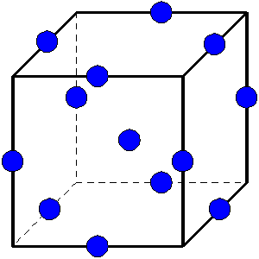
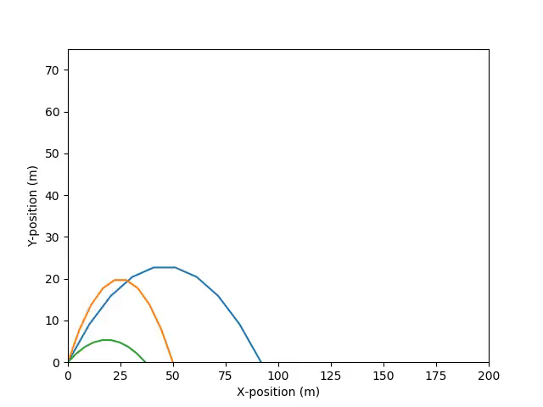
Entity: Samplers
Samplers: input space sampling entities
Forward Samplers
Monte-Carlo
Stratified (LHS)
Grid, etc
Adaptive Samplers (smart sampling)
Dynamic Event Tree Samplers

Slide 24
Input Structure: Samplers
<Samplers>
<MonteCarlo name='MCsampler'>
<samplerInit>
<limit>5000</limit>
</samplerInit>
<variable name='x’>
<distribution>x_distrib</distribution>
</variable>
</MonteCarlo>
<Grid name=’GridSampler’>
<variable name=‘x1’>
<distribution>x1_distrib</distribution>
<grid type=‘CDF’ construction=‘equal’ steps=’10’>
0.0 1.0
</grid>
</variable>
<variable name=‘x2’>
<distribution>x2_distrib</distribution>
<grid type=‘value’ construction=‘equal’ steps=‘8’>
0.1 0.9
</grid>
</variable>
</Grid>
</Samplers>
Distributions
Distributions
Samplers
Samplers
Optimizers
Models
DataObjects
Models
Outstreams
Databases
RunInfo
DataObjects
Steps
Databases
RunInfo
Steps

Slide 25
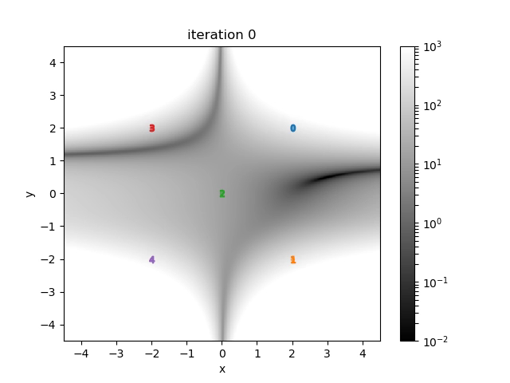
Entity: Optimizers
Optimizers: input space parameter optimization
Simultaneous Perturbation Stochastic Approximation (SPSA)
Finite Difference Gradient Descent
Conjugate Gradient*
* under development

Slide 26
Input Structure: Optimizers
<Optimizers>
<SPSA name=’optmizer'>
<initialization>
<initialSeed>42</initialSeed>
</initialization>
<convergence>
<gradientThreshold>1e-2</gradientThreshold>
<gainGrowthFactor>2</gainGrowthFactor>
</convergence>
<TargetEvaluation name=’DataObjects’ type=’PointSet'>
optimizationOutput
</TargetEvaluation>
<variable name='x’>
<lowerBound>0</lowerBound>
<upperBound>10</upperBound>
<initial>3.0</upperBound>
</variable>
<objectVar>outputToOptimize</objectVar>
</SPSA >
</Optimizers>
Distributions
Samplers
Optimizers
Models
Outstreams
DataObjects
Databases
RunInfo
Steps

Slide 27
Constructing Entities
OutStreams
Putting Results where they can be Used
Distributions
Sampler
Model
Data Object
OutStream
Step

Slide 28
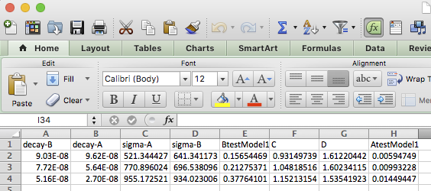
Entity: OutStreams
OutStreams: used for data exporting/dumping
Printing:
DataObjects
Reduced Order Models (ROMs)
Plotting: both 2D and 3D plotting available
4D by using color mapping
5D by using marker size

Slide 29
Input Structure: OutStreams
<OutStreams>
<Print name=’exportCSV'>
<type> csv </type>
<source>ADataObjectOrROM</source>
</Print>
<Plot name=’makeAPlot'>
<plotSettings>
<plot>
<type> scatter </type>
<x> ADataObject|Output|time </x>
<y> ADataObject|Output|anOutput </y>
</plot>
<xlabel> time <xlabel>
<ylabel> anOutput <ylabel>
</plotSettings>
<actions> <how> png, screen </how>
<title> <text> This is a plot </text> </title>
</actions>
</Plot >
</OutStreams>
Distributions
Samplers
Optimizers
Models
Outstreams
DataObjects
Databases
RunInfo
Steps

Slide 30
Constructing Entities
Steps
Connecting the Pieces
Distributions
Sampler
Model
Data Object
OutStream
Step

Slide 31
Steps
RunInfo
A Step links Entities together to perform an action
Multiple heterogeneous Entities are used in a single Step (DataObjects, Samplers, Models, …)
All these Entities must be defined in their corresponding block
They can be defined after the Steps block
Entity 1
Entity 2
…
Entity n
Steps
<Steps>
<StepType1 name=’simple_MultiRun'>
…
</StepType1>
<StepType2 name=’simple_PostProcess'>
…
</StepType2>
</Steps>

Slide 32
Steps
Each Entity has a role
Input
Output
Model
Sampler
etc
<Steps>
...
<MultiRun name=’StepName’>
<Input class=’Files’ type=’’>anInputFile.i</Input>
<Input class=’Files’ type=’’>anAuxiliaryFile</Input>
<Model class=’Models’ type=’Code’>aCode</Model>
<Sampler class=Samplers’ type=’MonteCarlo’>aSampler</Sampler>
<Output class=’Databases’ type=’HDF5’>aDatabase</Output>
<Output class=’DataObjects’ type=’History’>aData</Output>
</MultiRun>
</Steps>

Slide 33
Step Types (1/2)
SingleRun
Run a model once
MultiRun
Run a model many times
Change inputs for each sample
RomTrainer
Train a Reduced Order Model (ROM)
PostProcess
Act on all samples in a DataObject at once
RunInfo
Entity 1
Entity 2
…
Entity n
Steps

Slide 34
Step Types (2/2)
IOStep:
DataObject to Database (or vice versa)
Store or load data, HDF5
File to DataObject
Load data from CSV
DataObject to OutStream
Print CSV or plot
Model to File (or vice versa)
Serialize (“pickle”) ROM to file
Model to OutStream
Print ROM metadata information
RunInfo
Entity 1
Entity 2
…
Entity n
Steps

Slide 35
RunInfo
Desired analysis
Sequence of Steps
Working directory
Parallel computation parameters
…
RunInfo
Entity 1
Entity 2
…
Entity n
Steps
# of simultaneous code evaluations
<RunInfo>
<batchSize>6</batchSize>
<WorkingDir>./myDir</WorkingDir>
<Sequence>Step2,Step3,Step6</Sequence>
</RunInfo>

Slide 36
Review
RunInfo
Overview
What do I want to do?
How do I parallelize?
Entities
RAVEN Objects
What entities do I need?
What do they need to know?
Steps
Putting everything together
How will entities do what I want?
RunInfo
Entity 1
Entity 2
…
Entity n
Steps

